Slide 1
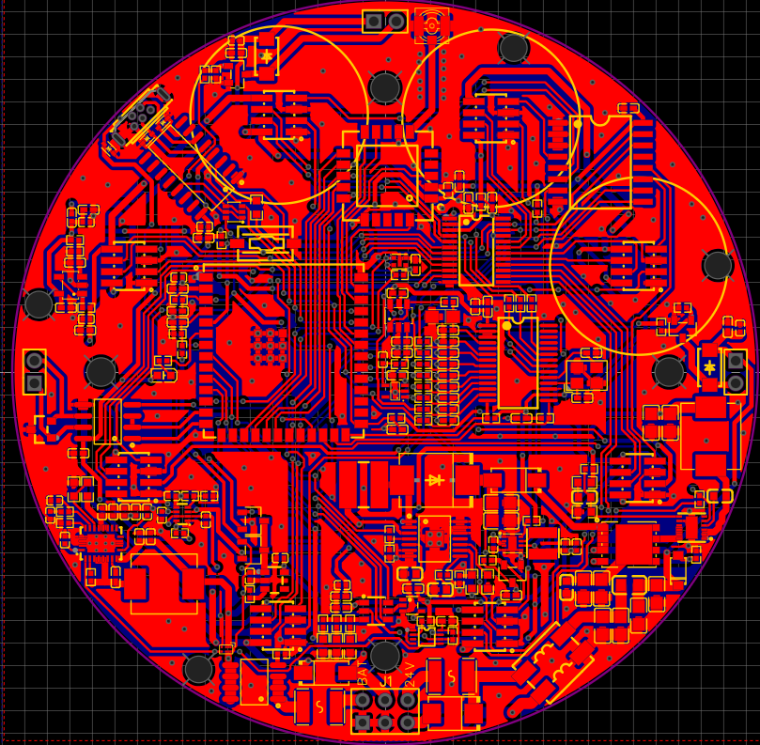
3
10
2
6
7
5
ESP32-S3
LoRa
Antenna
ADS1256
TCA9548
PCF8574
USB
RS485
Driver Alarm
Driver Fan
SHT40
Power Block
TPL5010
11
1
4
9
8
13
12

